Slide 1

D2D Beginner MicroStrategy Training
Self-Service Dashboard Creation
Presented By: Craig Mueller and Brandon Martin

Slide 2
Before We Get Started
Please make sure you do the following prior to the training session:
Ensure that you have access to the MicroStrategy on AWS training environment provided
(https://env-74697.customer.cloud.microstrategy.com/MicroStrategy/servlet/mstrWeb)
Download the dataset used for this training to your computer’s desktop
Find your assigned username provided by your instructor and log into the web environment provided.

Slide 3

Objectives
Setting Up
MicroStrategy Interface and Terminology
Data Visualization Best Practice
Importing Data
Building Data Visualizations
Uploading for Consumption
Q&A

Slide 4
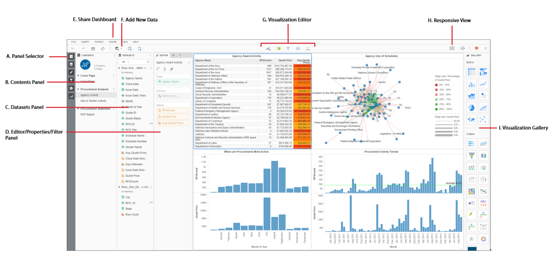
The MicroStrategy UI
Panel Selector – Choose which panels you want to view
Contents Panel – Table of Contents listing the Chapters and Pages of the MicroStrategy Dossier
Datasets Panel – List of Attributes and Metrics from your imported dataset that can be used to build visualizations
Editor/Properties/Filter Panel
Editor Panel – Drag and Drop data objects to build visualization
Properties Panel – Edit the look and feel of the visualization
Filter Panel – Add dataset objects to use as filters for your visualizations
Share Dashboard – give access to users who can view your dashboard, send them a link, or email your creation
Add New Data – Select to bring in new data from various data sources or existing dataset objects
Visualization Editor – Select to add a new visualization, filter, text, image, or HTML container
Responsive View – Edit how your dossier will look when viewed on different devices
Visualization Gallery – Select which visualization you would like to use on your dashboard

Slide 5
MicroStrategy Terminology
MicroStrategy Developer - a simple, but expansive tool geared towards MicroStrategy Administrators and MicroStrategy Developers. This tool provides extensive options and features to administer, create, and deploy solutions for any enterprise.
MicroStrategy Web - Design, navigation, settings, and administration in the MicroStrategy Web client interface, including Web authentication (Windows, Kerberos, LDAP, NT, Standard, Trusted) and web server configuration.
MicroStrategy Library - a personalized portal for every end user to access all their dossiers and report services documents. BI authors can easily share a link to dossiers or documents, which is hosted in the MicroStrategy Library.
Collaboration - consumers can now interact with each other via discussion threads or comments that can be made within a dossier or a document.
MicroStrategy Desktop - a fast, user-friendly desktop tool that lets you intuitively access and explore data to create visualizations in minutes on your PC or Mac. Easily access, explore, and analyze data in just a few clicks with self-service analytics. Experience the speed and flexibility of data discovery without sacrificing the scalability and security of an enterprise analytics environment.
MicroStrategy Workstation - our unified product built to radically simplify enterprise analytics by bringing all key workflows into a single user experience. This will allow enterprise BI developers and administrators to build and administer sophisticated enterprise and mobile analytics applications with a fraction of the effort it has traditionally taken.

Slide 6
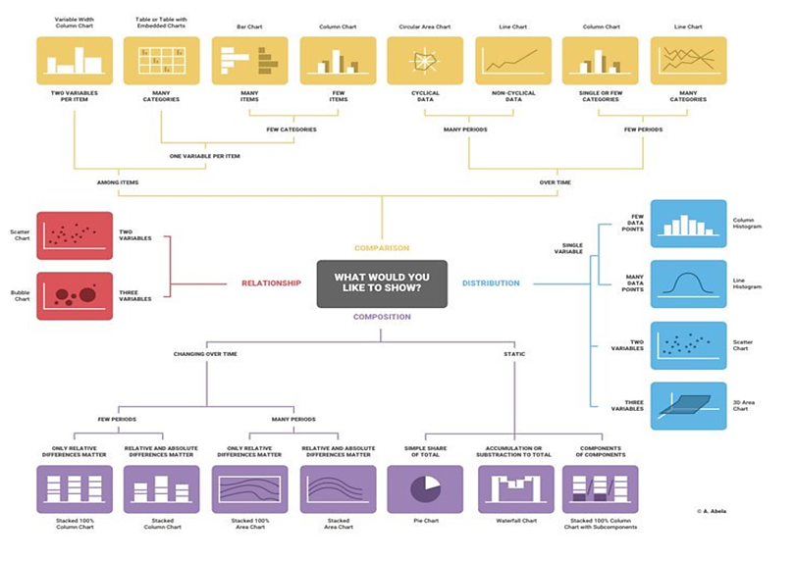
What Visualization Should I Use?

Slide 7
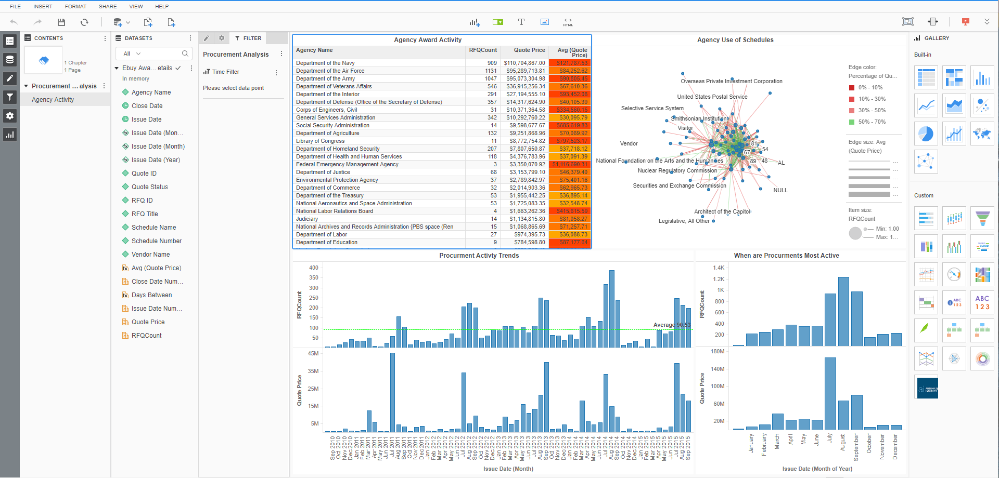
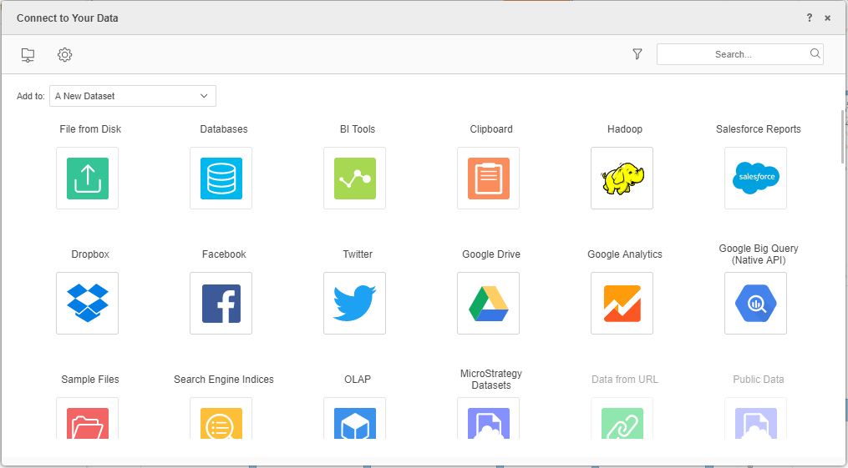
Import Your Data
Select Add New Data
Select File From Disk Data Type to bring in the Excel doc you downloaded at the beginning of the class

Slide 8

Questions?

Slide 9
Next Class
MicroStrategy Intermediate Training
Connecting to an Enterprise Database
Joining data from different sources
Data Wrangling
Custom and Advanced Metrics
Natural Language Generation

Slide 10
Thank you
For more information, Contact:
Chris Fleming: cfleming@microstrategy.com
Craig Mueller: rmueller@microstrategy.com
Brandon Martin: brmartin@microstrategy.com

Slide 11
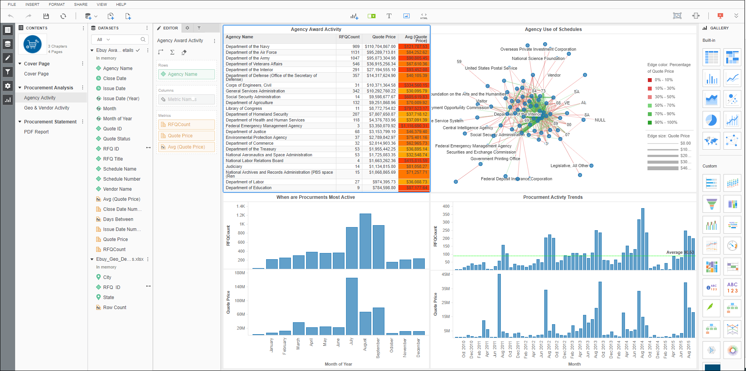
E. Share Dashboard
F. Add New Data
G. Visualization Editor
H. Responsive View
A. Panel Selector
B. Contents Panel
C. Datasets Panel
D. Editor/Properties/Filter Panel
I. Visualization Gallery

